Slide 1
Week 13 – Advanced models

Slide 2
Schedule
Today:
Time-series gls models (Slides 7-21)
Start Zero-inflated models (Slides 41-58)
Thurs
Zero-inflated cont. if needed
Final Project work
Tues Apr 27
Non-linear models (Slides 59-90)
Thurs Apr 29
Final Project work

Slide 3
Housekeeping
Peer review – in class on Tuesday May 4. You NEED to upload your materials by 1:00 PM!
Final project due Monday May 10 at midnight

Slide 4
SPOT surveys
SPOT surveys are available on Canvas on 4/23
Please complete these as it helps me both justify and improve the course
There are also super important for tenure evaluations. My review committee will actually read your comments!

Slide 5
An important point about model comparison!
When you compare models, it is very, very important to compare models that all have the same number of observations!!!!
For example, if you want to predict bat infection by species and temperature.
Your models look like this: infection~temp+species, infection~species
You might have forgotten to take a temperature from every individual (but you always recorded species). You will need to drop all measurements where you don’t have temperature to compare models USING ANY METHOD.

Slide 6
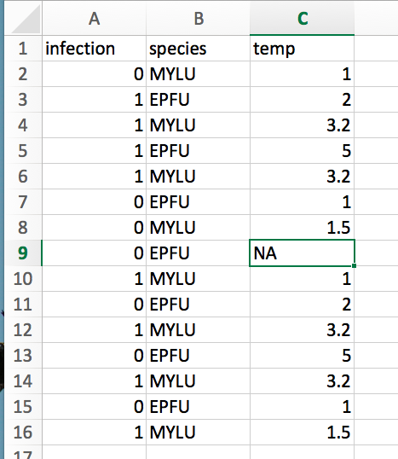
If we fit the models, infection~species, we would have 16 observations
Infection~species+temp, we have 15 observations
We can not validly compare these models.

Slide 7
Outline – Time-series models and correlated Data
Lack of independence among data points in a serious issue in statistics
These processes can be driven by any number of factors. Two important processes we will cover are:
1) Time-series issues (temporally auto-correlated data) (Slides 7-21)
This year we will not cover (but feel free to look at ppt):
2) Phylogenetic issues (species are not independent data points)
What is another super important correlation in much of ecology/evolution?

Slide 8
Generalized least squares (GLS)
GLS models are a generalization of linear models (ordinary least squares)
They allow us to include matrices which explicitly account for correlation in data. For it to work, we need to have enough data to be able to accurately estimate correlations.
For this reason generalized least squares is especially suitable for temporal data that consist of long time series. Because it's least squares, it is most appropriate when the response variable can be assumed to be normally distributed.
We will start with temporal data (because it is simpler) but can also be used with phylogenetic data

Slide 9
Temporal data (time-series)
Temporal correlation is one-dimensional and unidirectional. We only have to worry about the effect that the past has on the present, not vice versa.

Slide 10
Generalized least squares (GLS)
Because it generalizes ordinary least squares, generalized least squares (GLS) is largely restricted to situations in which a normal distribution makes sense as a probability model for the response.
But remember, normal models are often robust to violation of assumptions.
For non-normal correlated data the choices are a bit murkier.
But what are some things we could do?

Slide 11
How does GLS work?
Generalized least squares (GLS) generalizes ordinary least squares to the case where the residuals (errors) have a normal distribution with an arbitrary covariance matrix.
So as was the case with ordinary least squares we end up with an exact formula for the regression parameters, this time in terms of the design matrix and the unscaled covariance matrix V. Unfortunately the formula requires that we know V, so typically we'll need to estimate it first.
To make this problem feasible and to avoid overparameterization, the usual approach is to assume that V has a very simple form, a correlation structure that is based on a small number of parameters, and to jointly estimate the regression parameters and the covariance parameters. There are specific algorithms for special correlation structures, but a general approach is to use maximum likelihood estimation.

Slide 12
How does GLS work?
Imagine fitting a regression model to some temporal data (e.g. number of mosquito species over years)
We can make some assumptions about the residuals (e.g. the error that is left over after fitting)
These assume that:
1) Their mean is not changing.
2) The correlation between the residuals is only a function of their relative temporal position and is not related to their absolute temporal position.
Because of the second assumption, we can identify the autocorrelation among residuals by examining time lags.

Slide 13
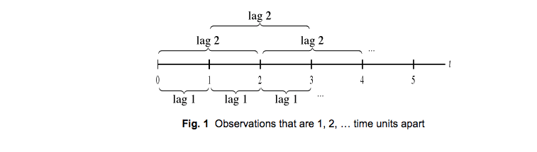
Lags

Slide 14
Autocorrelation
Autocorrelation is the linear dependence of a variable with itself at two points in time
e.g. The average number of bats in 2001 should be predicted by the average number of bats in 2000
The temperature today depends on the temperature yesterday (usually)

Slide 15
Partial autocorrelation
Partial autocorrelation is the autocorrelation between y_{t} and y_{t–lag} after removing any linear dependence.

Slide 16
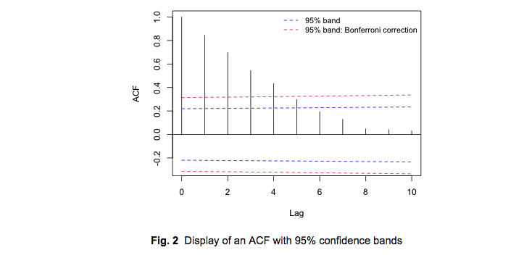
ACF Plot
We expect with temporally ordered data that the correlation will decrease with increasing lag. Here the correlation decreases exponentially with lag.
This says what is the correlation between 1 v. 2, 1 v. 3, 1 v 4, 1 v 5, etc.

Slide 17
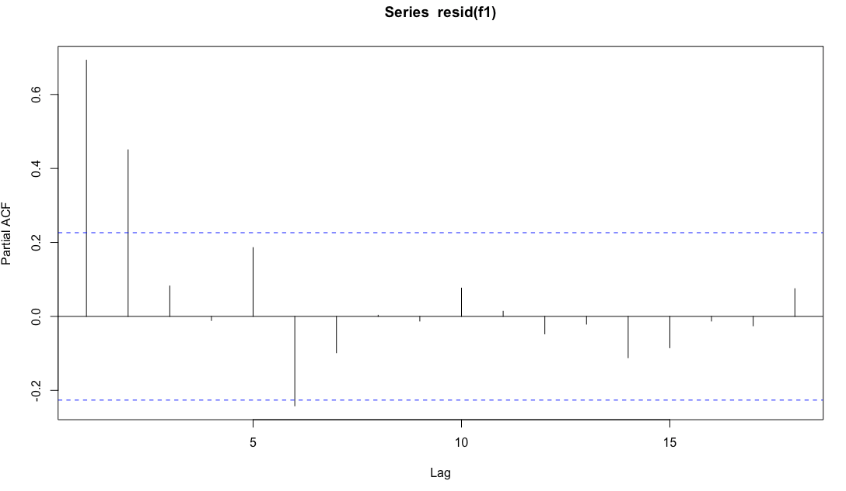
Partial autocorrelation
Another useful diagnostic the partial autocorrelation function (PACF).
Here, you can regress each residual against lagged residuals at different time points.
Significant spikes will help to inform you about when the autocorrelation disappears between lags
This says what is the correlation between 1 v. 2, 1 v. 3 (after accounting for correlation between 1 and 2).

Slide 18
Some types of autocorrelation models
AR(p, autoregressive) models, where p is a given lag number
Examine the lag residuals to determine when the significant correlation among residuals disappears
Autocorrelation often decreases exponentially to 0
Often just a single spike
MA (q, moving average models)
Autocorrelation with one or more significant spikes, and the rest of the spikes are near 0
Autoregressive moving average (ARMA, p,q)
ACF exhibits a few significant spikes followed by a decay.
The ACF and PACF are hybrids of the AR(p) and MA(q) patterns

Slide 19
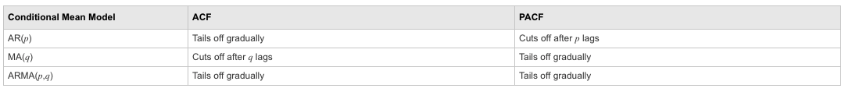
Summary of what plots look like for different models

Slide 20
Digger deeper
This is a REALLY brief introduction to time-series models (which are complicated!)
Additional resources:
http://www.unc.edu/courses/2010spring/ecol/562/001/docs/lectures/lecture9.htm
http://www.unc.edu/courses/2010spring/ecol/562/001/docs/lectures/lecture10.htm
https://socialsciences.mcmaster.ca/jfox/Books/Companion/appendix/Appendix-Timeseries-Regression.pdf
http://www.stats.uwo.ca/faculty/braun/ss359a/2004/notes/Chapter14/glsnotes.pdf
People seem to like this book: https://www.amazon.com/dp/144197864X/?tag=stackoverflow17-20
And see this post: https://stats.stackexchange.com/questions/20514/books-for-self-studying-time-series-analysis

Slide 21
Go to R…

Slide 22
Species as data points
Outline
The problem with species data
Phylogenetic signal in ecological traits
Why phylogeny matters in comparative study
Phylogenetically independent contrasts (PICs)
A linear model approach
A method for discrete data (and issues)

Slide 23
An example
Mating behaviors in 15 species of water striders (Gerris) (Rowe and Arnqvist 2002).
Biology: Males chase females, who flee by skating away. If a male grasps a female, she initiates a series of leaps, rolls, and summersaults that usually toss him off. Males of some species have clasping genitalia that allow them to stay on longer, but females of these species often have spines or other devices that make it difficult for males to grasp her. Mating takes place after a female stops struggling.
Variables to correlate are average duration of female struggles for each species, which are the periods of evasive action by females in response to lunges or grasps by males; and average mating frequency of females, measured under controlled lab conditions.

Slide 24
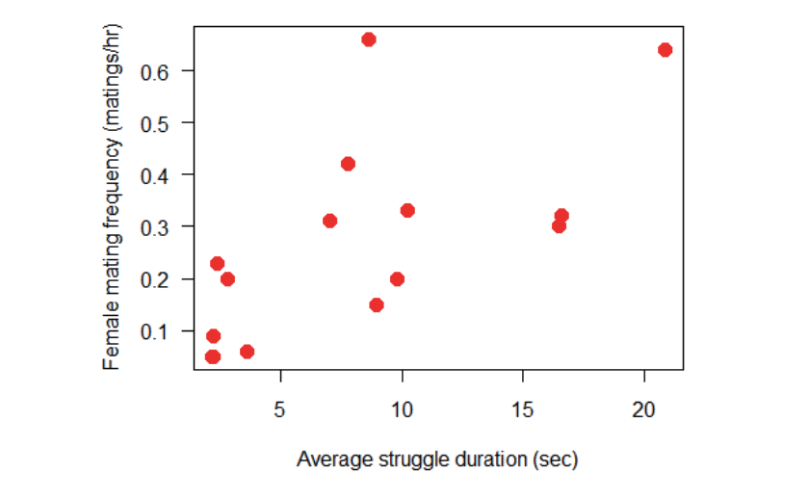
How are the variables related?
Data reveal a positive association between the two variables.
We would like to estimate the strength of the correlation.

Slide 25
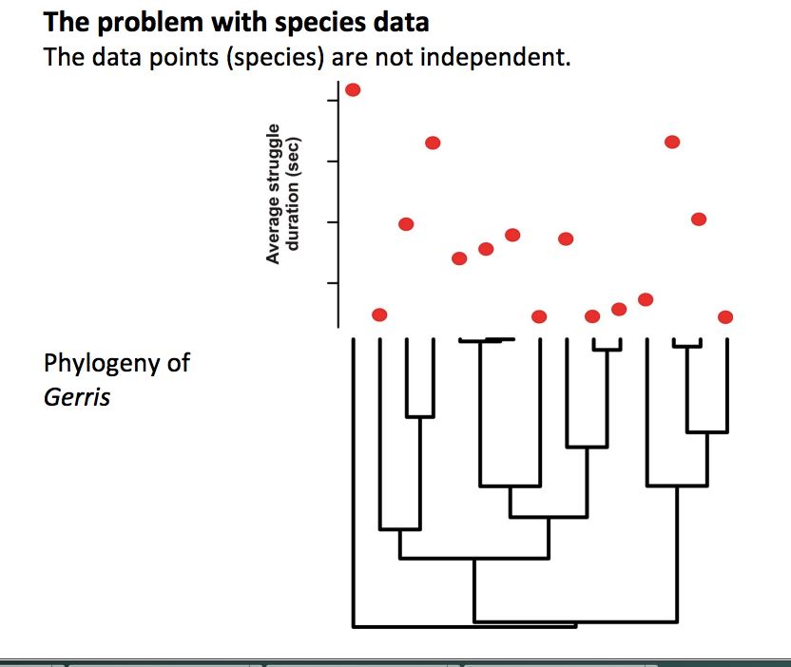

Slide 26
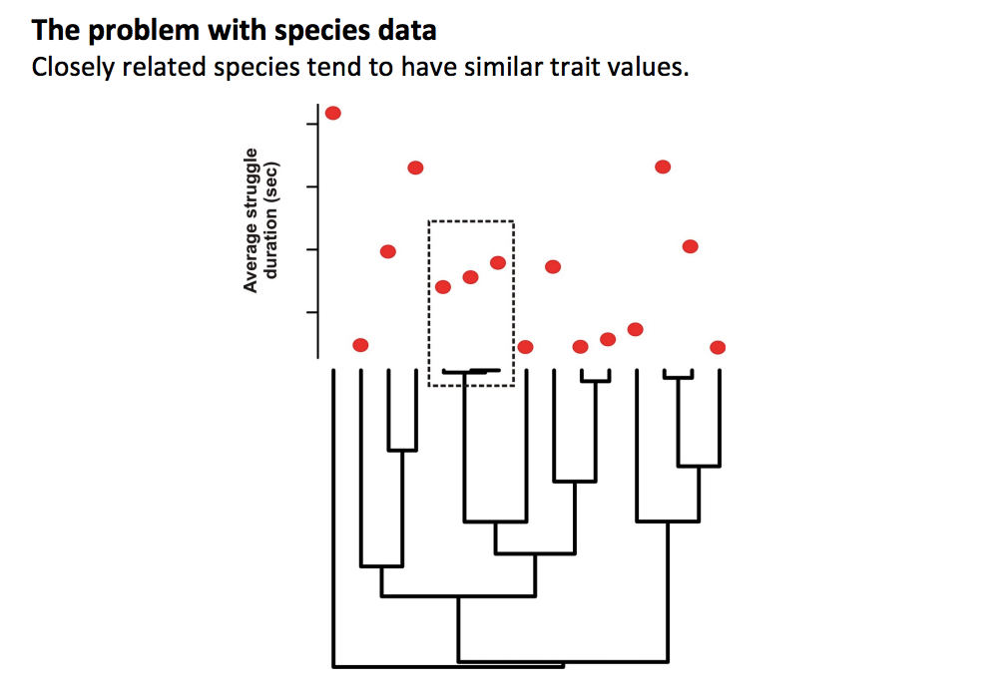
This is called phylogenetic signal

Slide 27
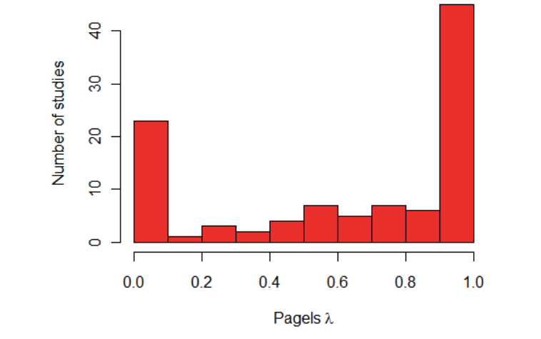
How prevalent is this problem?
Pagel’s λ measures the extent to which closely related species are similar in their trait values (phylogenetic signal). Here is a survey of λ-values from many studies and traits by Freckleton et al (2002):

Slide 28
Why is phylogenetic signal a problem?
We violate assumptions
We calculate our errors wrong
First highlighted by Joe Felsenstein - Felsenstein, J. (1985). "Phylogenies and the Comparative Method". The American Naturalist. 125: 1–2. doi:10.1086/284325.
EVERYONE should read this paper!!!

Slide 29
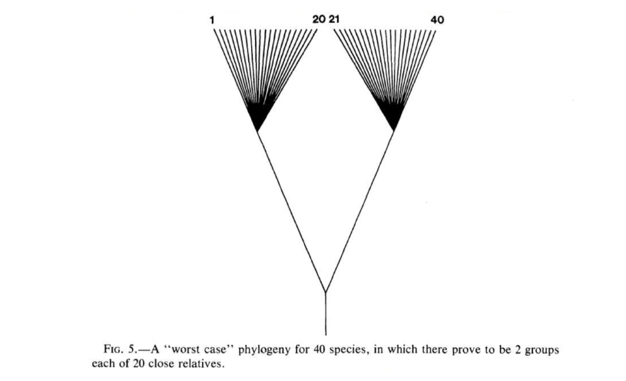
Worst case scenario phylogeny

Slide 30
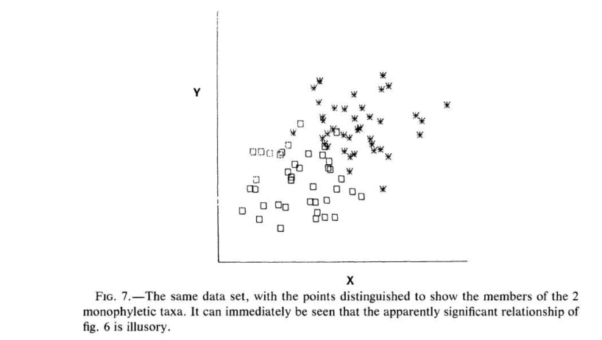
Ignoring phylogenetic signal

Slide 31
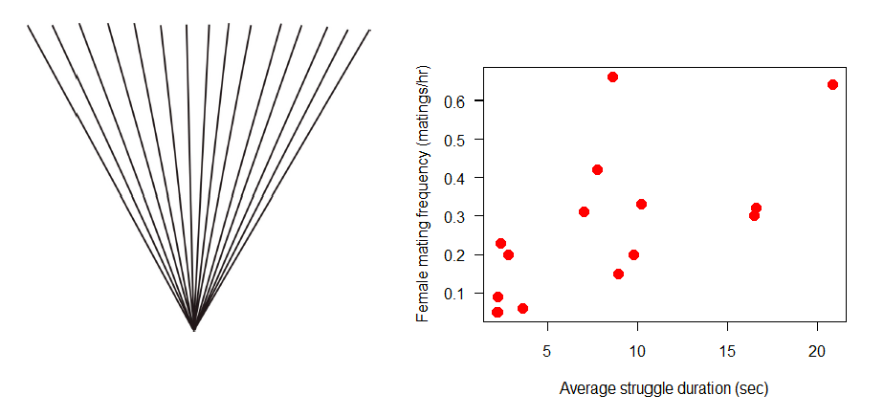
What we would actually be assuming about phylogeny when we ignore it

Slide 32
Felsenstein’s (1985) solution
Method assumes that the evolution of traits is mimicked by a continous random walk (Brownian motion)
Under Brownian motion, the difference between two species in a trait value has a normal probability distribution with a mean = 0, and a variance proportional to the time since their common ancestor

Slide 33
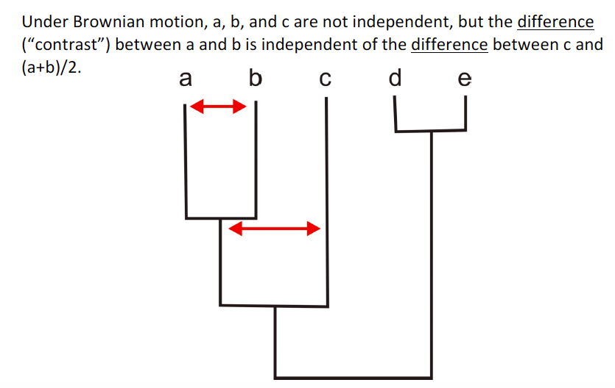
Felsenstein’s phylogenetically independent contrasts

Slide 34
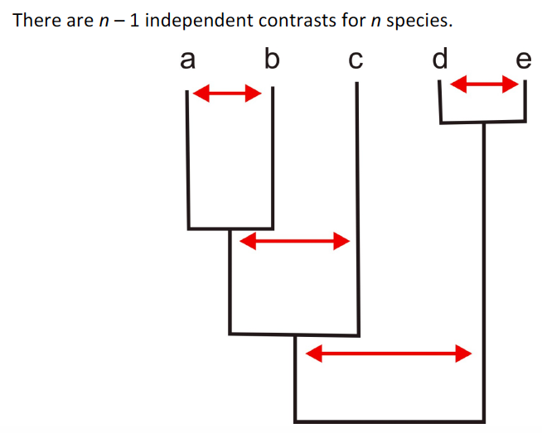
Felsenstein’s phylogenetically independent contrasts

Slide 35
Assumptions of PICs
Evolution in each trait mimics a continuous random walk in time (Brownian motion);
The rate of evolution is constant through time and along all branches of the phylogeny
Speciation and extinction are unrelated to trait values.
These seem difficult to verify.
If the assumptions are not met, then in extreme cases using independent contrasts might be worse than simply treating the species data as though they were independent (Harvey and Rambaut 2000).

Slide 36
Linear Model (GLS) approach
Mathematically equivalent to PICs
Gives access to all the suite of linear model tools
Incorporates correlation (e.g. phylogenetic signal) among trait values using a weighted matrix of expected covariance between data points

Slide 37
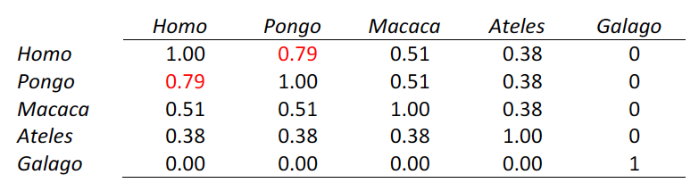
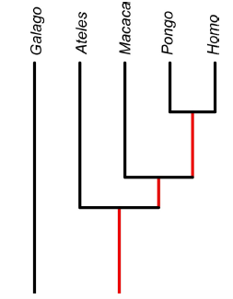
Specifying the covariance matric between data points

Slide 38
The result of including phylogeny
Data points from closely related species are down-weighted
Conversely, similar trait values between distantly related species can result in a stronger overall relationship

Slide 39
Resources
http://schmitzlab.info/pgls.html
https://lukejharmon.github.io/ilhabela/instruction/2015/07/03/PGLS/

Slide 40
Go to R…

Slide 41
Additional Topic: Zero-inflated models

Slide 42
Goals
Introduce zero-inflated models
Understand the difference between mixture and hurdle models
Learn to assess whether your data is a better fit for one type of model of the other
Examine the output of a zero-inflated model in R

Slide 43
The Zero Problem
Too many zeros can cause models to fit poorly, including over/under dispersion
This is a BIG problem because it one of the few issues in which we are MORE likely to get a significant result because we haven’t properly accounted for dispersion

Slide 44
Negative Binomial
We can frequently solve this problem by using the negative binomial distribution – this will allow us to have a more dispersed count dataset than Poisson
However, too many 0s can muck with your fits resulting in either
1) an underdispersed nb fit (which may indicate a zero-inflated poisson would be best)
2) a negative-binomial model that doesn’t fit the data well (or perhaps doesn’t even run!)

Slide 45
Zero-inflated models
We use zero-inflated models to account for “excess” zeros in the dataset
These start with a probability distribution that underestimates the number of zeros in a data set and then "corrects" this distribution in a particular way to account for the extra zeros.
While an excess zero model can be tacked onto almost any distribution, zero-inflated Poisson and zero-inflated negative binomial are most common (and well-implemented in R)

Slide 46
Types of zero-inflated models
Excess zeros models fall into two broad categories depending on how the "correction" is done. They are the following.
Mixture models (zero-inflated models proper).
Lambert (1992) is the usual citation
Conditional models (called hurdle models).
In ecology Welsh et al. (1996) is often cited.
Notes:
https://www.unc.edu/courses/2006spring/ecol/145/001/docs/lectures/lecture18.htm#excess

Slide 47
Mixture model
In the mixture model we assume the observed zero counts are a heterogeneous mixture and come from two sources.-
Some of the observations are zero just by chance, i.e., the Poisson law predicts that some proportion of events will yield zero counts. This proportion is given by the g₂ distribution.
The rest of the zeros are generated by a different probability generating mechanism altogether. This is the g₁ distribution.
A good example of where a heterogeneous population of zeros might arise is in habitat suitability models.
If we're dealing with a rare species then we would expect there to be zero counts in our sample because some of the sampled habitat is simply unsuitable for the species to exist, either for biological or non-biological reasons.
On the other hand even if we restrict ourselves to suitable habitat, the species might by chance still fail to occur in some of our samples. We would classify these sites as locations where the species could theoretically thrive, but for whatever reason doesn't, either because it hasn't reached the site yet or perhaps it has reached the site but was then locally extirpated, or any number of other reasons.

Slide 48
Hurdle Models
Hurdle models are easy to motivate when it makes sense to separate processes into those that lead to the presence or absence of a population and those that facilitate continued maintenance of a population. This would be the case in habitat suitability models that treat colonization and growth as separate processes and treat the possibility of subsequent extinction as unlikely.
Often in both mixture and conditional models the primary goal is to develop separate regression models for two processes.
However, hurdle models use separate log-likelihoods for the parameters explaining 0/not zero and those involved in explaining the rest of the distribution. This facilitates estimation because the presence-absence portion of the model is fit separately from the model for the nonzero counts.
The parameters also have a clean interpretation. The parameters related to presence-absence deal with habitat invasion while those used to predict the non-zero data relate to sustaining the population once it gets established and there is no overlap between them.

Slide 49
In R
The R package pscl provides implementations of excess zero models.
Poisson and negative binomial distributions for the nonzero counts are supported.
There is the suggestion in the literature that zero-inflated negative binomial (ZINB) models often have convergence problems (Famoye and Singh 2006).
It's worth noting that Warton (2005) argues that many of the published uses of excess zero models may be unnecessary - he argues that the negative binomial probability model is often for environmental and ecological data.

Slide 50
Go to R…

Slide 51
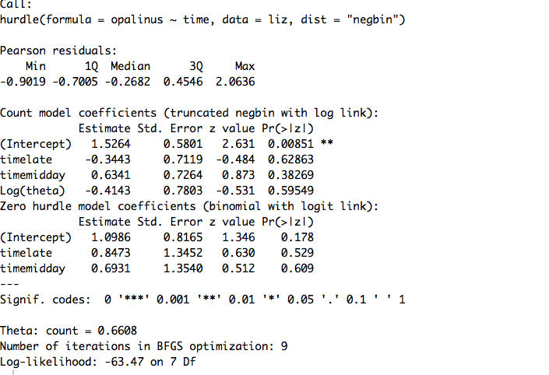
What does this give us?

Slide 52
This is a two-component model:
A truncated count component, such as Poisson, geometric or negative binomial, is employed for positive counts
A (binary) component models zero vs. larger counts.

Slide 53
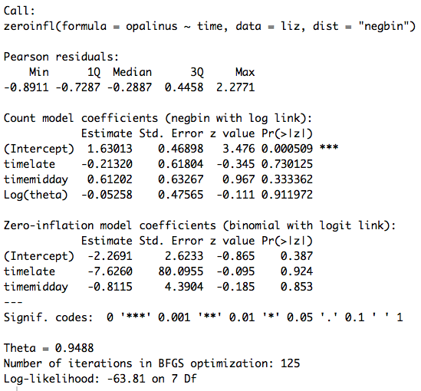
What does this give us?

Slide 54
This is still a two-component models
But the neg. bin. distribution is not truncated (e.g. some zeros are part of the neg. bin. process, and some are part of the binomial process)

Slide 55
Which model is best?
Note that the model output does not indicate in any way if our zero-inflated model is an improvement over a standard nb regression.
We can determine this by running the corresponding nb model and then performing a Vuong test of the two models.

Slide 56
Vuong test
The Vuong tests the null hypothesis that the two models are equally close to the true data generating process, against the alternative that one model is closer. It cannot make any decision whether the "closer" model is the true model. It can be used for non-nested models and seems to be what is in vogue for testing zero-inflated models.
There is some evidence to suggest the Vuong test might not be appropriate for this because the models aren’t truly nested. (The authors of this paper seem to suggest we should just use negative-binomial methods).
AIC is another possibility, but I found a post on stack exchange where someone referred the poster to the Vuong test and said AIC isn’t good!
In general, there seems to be some uncertainty.
You could always double check predictive accuracy through cross-validation. And a good check is to plot your model and your data using all different models.
As with all model comparisons, it is not a bad idea to use multiple methods to determine whether they agree.

Slide 57
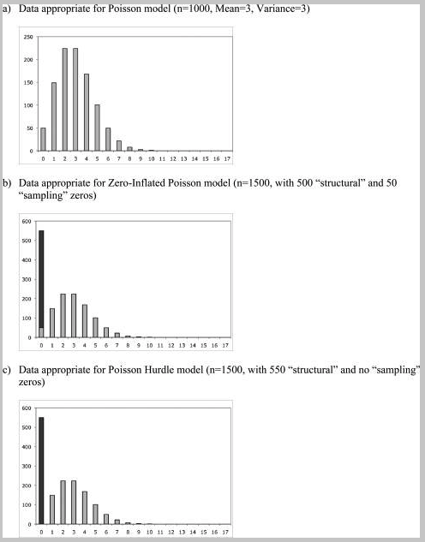
Comparison of data for model types - Poisson
Hu 2012, paper on canvas

Slide 58
Zero-inflated problems
Using the opalinus~time lizard data, examine the difference between a zero-inflated Poisson and a zero-inflated negative binomial. Compare these models.
Predict the better model and plot the model and data using ggplot.

Slide 59
Advanced Topics Non-linear models

Slide 60
Goals
Introduce non-linear models and functions in ecology and evolutionary biology
Fit a non-linear model in R using least squares

Slide 61
Review – linear regression
Linear relationships assume a linear relationship between our predictor and our dependent variable
What is the equation for a basic linear model?
We use lm() to make linear models in R.
Fit using least squares
What does this assume?

Slide 62
Non-linear relationships
Lots of relationship are not lines!

Slide 63
Non-linear relationships
Sometimes we have a non-linear relationship between a predictor and a response variable
Notes:
What are these different responses?

Slide 64
Questions to ask yourself when there is non-linearity
Can a GLM be used?
Is there a range at which the data are linear?
Do I care about predicting the future?
Do I need to use a “real” model as compared to a statistical model?

Slide 65
Modelling vs Statistics
Two different processes
Can be totally independent skillsets
Mathematical modeling: Dynamical processes of biological systems (ODEs, PDEs)
Ex: Predator-Prey Models, Infectious disease models, logistic population growth models
Statistics: The types of things we learned about in this class
Interface – fitting model to data using statistical inference
Often involves some of the same fitting algorithms you have used “behind the scenes” in this class
Could involve writing your own likelihood function using things learned in distributions lecture to minimize the negative log likelihood
Could use Bayes theorem and MCMC to estimate parameter values
Could use totally different approaches (ABC,particle-filtering)

Slide 66
Non-linear functions
Non-linear functions are variable across fields
Can have non-linear functions where parameters have very specific meaning
e.g. Type II Holling functional response
Can have non-linear functions which take a “shape” that fits your data
Application of the above function to non-predator prey dataset

Slide 67
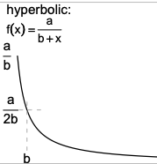
Hyperbolic functions
Used in models of plant competition to fit seed production as a function of plant density
Mechanistic understanding: if resources per unit area are constant, the area available to the plant for resource exploitation might be proportional to 1/plant density

Slide 68
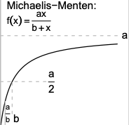
Michaelis-Menten function
Introduced for enzyme kinetics, but used for lots of things
Resource competition (called Monod function)
Fisheries biology (called Beverton-Holt model, mortality rate~density)
Predator-prey dynamics (Type II)
Starts at 0 when x=0, and approaches asymptote as a gets large
Asymptote occurs ”slowly”: (x/1+x) is halfway to asymptote when x=1, 90% when x=9

Slide 69
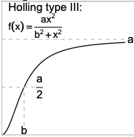
Holling type III response
Slightly more S shaped than the type II response
Can occur due to predator switching

Slide 70
Exponential functions

Slide 71
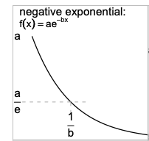
Simple exponentials
Exponential growth
ae^(bx)
Exponential decay
ae^(-bx)
Also called:
“catalytic curve” change in the fraction of a cohort exposed to a pathogen
“von Bertalanffy” growth curve – effect of size on metabolic rate
“Skellam model” – population ecology as number of offspring in next year as a function of the number of adults this year
Two parameter functions – a is the starting or final size, and the exponential rate “b”

Slide 72
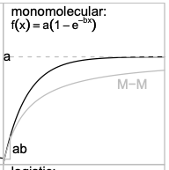
Monomolecular exponential
Saturating growth
Multiplier is a, final pop size (asymptote)
Exponential rate “b” – the time needed to reach e time the initial value
M-M is the michaelis-menten

Slide 73
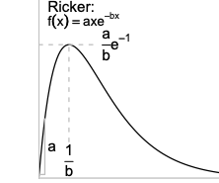
Ricker function
Can reflect density-dependent population growth (pop size on x, growth rate on y)
Very widely used for ecological variables that start at 0, increase to a peak, and decrease gradually toward 0

Slide 74
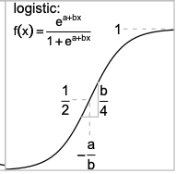

Logistic function
There are different way to parameterize the logistic function
In population ecology, more commonly written as:
K is carrying capacity, n0 is pop size at time=0, and r is per capita growth rate

Slide 75
There are many, many, many non-linear functions
See resources on Canvas

Slide 76
Fitting non-linear functions in R
The most commonly used package for fitting non-linear functions with least squares is “nls()”
What assumptions must we meet?

Slide 77
Using nls
To use nls, we must
(1) input a formula, including our parameters
(2) input some starting vales
(3) cross our fingers that we have generally chosen starting values well

Slide 78
Comparing model fits
It can be difficult to compare non-linear model fits
One way to do this is the mean squared error
mean(resid^2)
If you are using the same data and predictors, you want the lower value

Slide 79
Go to R…

Slide 80
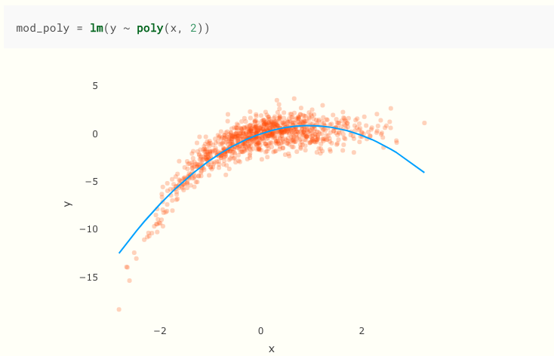
Other solutions for non-linear data
Polynomial regression
Transform x variable (e.g. quadratic to x^2)

Slide 81
Piecewise/Segmented regression
Y variable is partitioned into multiple components
“segmented” package of either lm or glm
https://www.r-bloggers.com/r-for-ecologists-putting-together-a-piecewise-regression/

Slide 82
Generalized additive models
GAMs apply smoothing functions to x variables
A general form is : y ~ f(x) + y
It is a kind of penalized GLM with and adds additional penalty for coefs that making the curve super wiggly
Limitations:
GAMS can still overfit data quite a bit (penalty doesn’t solve that issue)
Model will lose predictability outside of dataset range (precision to data vs predictability outside)
They are non-mechanistic –coef interpretation is challenging.

Slide 83
GAMs in R
Widely implemented and easy to use
gam() in the mgcv package
a <- gam(tminc~s(Jdate),data=wisco, method=“REML”)
plot(a,pages=1,seWithMean=TRUE) #
http://environmentalcomputing.net/intro-to-gams/
A highly recommended free course: https://noamross.github.io/gams-in-r-course/

Slide 84
Other options
Models that account for processes
Often called “compartmental models”
Usually ordinary differential equations or partial differential equations

Slide 85
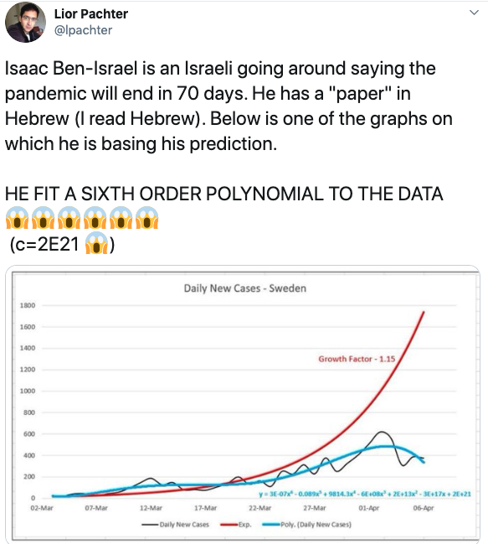
Why we can’t just fit polynomials to process based models

Slide 86

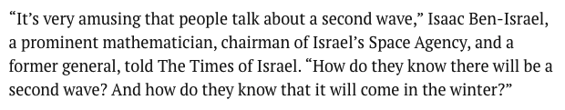

Slide 87

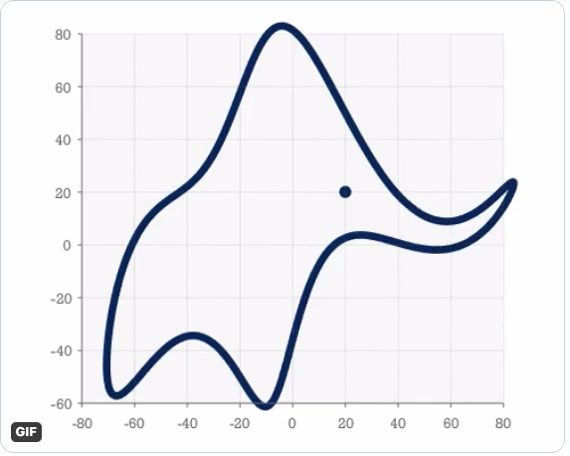

Slide 88
Advantages of modeling the process…
We can make better predictions
We understand why inflection points are changing
Every parameter has an explicit meaning

Slide 89
Example: Infectious Disease Models

Slide 90
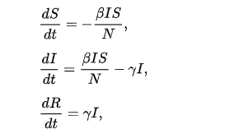
Example: Infectious Disease Models
Could ask:
How does the rate of transmission (e.g. Beta) vary across populations?
How big will an epidemic be? How many people will be infected?
Test different model formulations: Does transmission depend on population size?

Slide 91
Exercise
Working in group, identify a non-linear relationship in your data or theirs
Identify whether any of the functions you learned about today would apply to these relationships
Experiment with fitting a non-linear model to your data

Slide 92
Power analyses
The go-to package for simple power analyses in R is the pwr package
function | power calculations for
pwr.2p.test | two proportions (equal n)
pwr.2p2n.test | two proportions (unequal n)
pwr.anova.test | balanced one way ANOVA
pwr.chisq.test | chi-square test
pwr.f2.test | general linear model
pwr.p.test | proportion (one sample)
pwr.r.test | correlation
pwr.t.test | t-tests (one sample, 2 sample, paired)
pwr.t2n.test | t-test (two samples with unequal n)

Slide 93
Power analyses
The following four quantities have an intimate relationship:
sample size
effect size (I suggest choosing 0.8)
significance level = P(Type I error) = probability of finding an effect that is not there
power = 1 - P(Type II error) = probability of finding an effect that is there

Slide 94
Real life
Unless you are doing an experiment, real life is often more complicated than this
I recommend doing a simulation, create some fake datasets and run the stats on your made-up datasets
How many samples would you need to detect a significant effect? How much different do your groups need to be, etc?
Also see our Distributions lecture – these are very helpful for thinking about experimental design and analyses!

Slide 95
Power analyses – more info
http://www.biostathandbook.com/power.html
Running in R:
https://www.statmethods.net/stats/power.html

Slide 96
Interactive apps in Shiny
The go-to platform for interactive graphics or tables, etc. is Shiny
E.g. library(shiny)
You can host apps for free on Shiny’s website
You can find the directions here: https://shiny.rstudio.com/articles/shinyapps.html
The key is that you need two files in a folder. The folder is the name of your app, and the files are called ui.R and server.R
File server.R has the R code you are running for your calculation or your graph
File ui.R has the app design information
Run the app in a new R script window with runApp("sampleapp")
After you set up rsconnect and shiny, and inputting your token and secret information (see above), you can publish your app by clicking “publish” in the app screen
https://klangwig.shinyapps.io/sampleapp/

Slide 97
Bayesian Models
What is the frequentist perspective?
What is the Bayesian perspective?
Lecture based on https://www.r-bloggers.com/2019/05/bayesian-models-in-r-2/ with examples in brms

Slide 98
Frequentist perspective
How do we estimate an unknown parameter?
Think of flipping a coin 1000 times, and you don’t know if it is biased
f(H) = # heads / 1000
What is the estimated probability of heads?
This is the maximum likelihood estimate and reflects modern frequentist perspective

Slide 99
Bayesian perspective

